Slide 1

Cloud Application Development

Slide 2
Outline
Design Considerations for Cloud Applications
Cloud Application Design Methodologies
Reference Architectures for Cloud Applications
Python Web Application Framework - Django

Slide 3
Design Considerations for Cloud Applications
Scalability
Reliability & Availability
Security
Maintenance & Upgradation
Performance

Slide 4
Cloud application design methodologies
SOA
Service Oriented Architecture
MVC
Model View Controller
REST
Representative State Transfer
RESTful Web Services

Slide 5
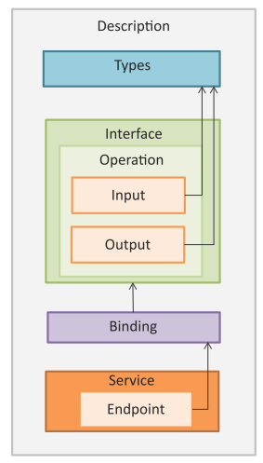
Service Oriented Architecture
Service Oriented Architecture (SOA) is a well established architectural approach for designing and developing applications in the form services that can be shared and reused.

Slide 6
Service Oriented Architecture
SOA is a collection of discrete software modules or services that form a part of an application and collectively provide the functionality of an application.

Slide 7
Service Oriented Architecture
SOA services are developed as loosely coupled modules with no hard-wired calls embedded in the services.
The services communicate with each other by passing messages.

Slide 8
Service Oriented Architecture
Services are described using the Web Services Description Language (WSDL).
WSDL is an XML-based web services description language that is used to create service descriptions containing information on the functions performed by a service and the inputs and outputs of the service.

Slide 9
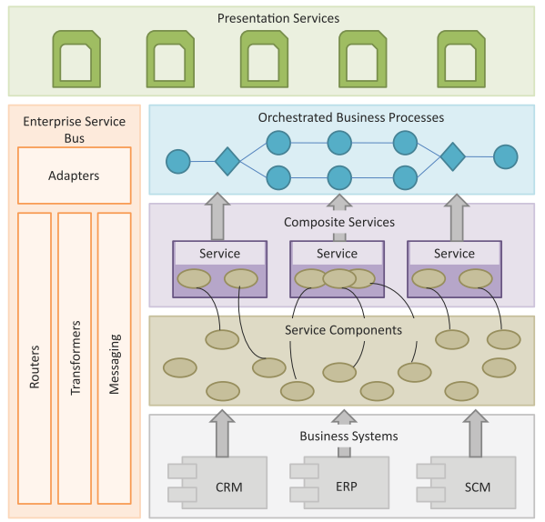
SOA Layers
Business Systems
Service Components
Composite Services
Orchestrated Business Processes
Presentation Services
Enterprise Service Bus

Slide 10
SOA Layers
Business Systems
This layer consists of custom built applications and legacy systems such as Enterprise Resource Planning (ERP), Customer Relationship Management (CRM), Supply Chain Management (SCM), etc.

Slide 11
SOA Layers
Service Components
The service components allow the layers above to interact with the business systems. The service components are responsible for realizing the functionality of the services exposed.

Slide 12
SOA Layers
Composite Services
These are coarse-grained services which are composed of two or more service components. Composite services can be used to create enterprise scale components or business-unit specific components.

Slide 13
SOA Layers
Orchestrated Business Processes
Composite services can be orchestrated to create higher level business processes. In this layers the compositions and orchestrations of the composite services are defined to create business processes.

Slide 14
SOA Layers
Presentation Services
This is the topmost layer that includes user interfaces that exposes the services and the orchestrated business processes to the users.

Slide 15
SOA Layers
Enterprise Service Bus
This layer integrates the services through adapters, routing, transformation and messaging mechanisms.

Slide 16
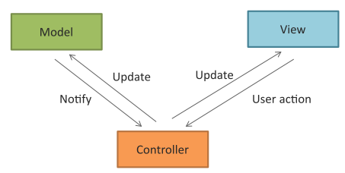
Model View Controller
Model View Controller (MVC) is a popular software design pattern for web applications.
Model
View
Controller

Slide 17
Model View Controller
Model View Controller (MVC) is a popular software design pattern for web applications.
Model
Model manages the data and the behavior of the applications. Model processes events sent by the controller. Model has no information about the views and controllers. Model responds to the requests for information about its state (from the view) and responds to the instructions to change state (from controller).

Slide 18
Model View Controller
Model View Controller (MVC) is a popular software design pattern for web applications.
View
View prepares the interface which is shown to the user. Users interact with the application through views. Views present the information that the model or controller tell the view to present to the user and also handle user requests and sends them to the controller.

Slide 19
Model View Controller
Model View Controller (MVC) is a popular software design pattern for web applications.
Controller
Controller glues the model to the view. Controller processes user requests and updates the model when the user manipulates the view. Controller also updates the view when the model changes.

Slide 20
RESTful Web Services
A RESTful web service is a web API implemented using HTTP and REST principles.
Representational State Transfer (REST) is a set of architectural principles by which you can design web services and web APIs that focus on a system’s resources and how resource states are addressed and transferred.
The REST architectural constraints apply to the components, connectors, and data elements, within a distributed hypermedia system.
The REST architectural constraints are as follows:
Client-Server
Stateless
Cacheable
Layered System
Uniform Interface
Code on demand

Slide 21
Reference Architectures for Cloud Applications

Slide 22
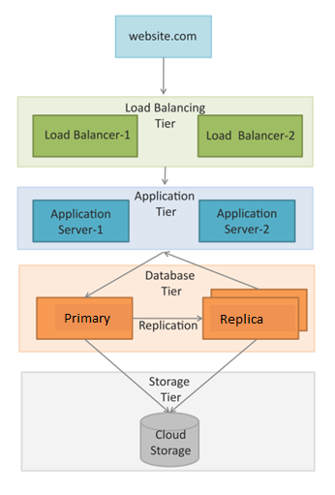
Reference Architectures – e-Commerce, Business-to-Business, Banking and Financial apps
Load Balancing Tier
Load balancing tier consists of one or more load balancers.
Application Tier
For this tier, it is recommended to configure auto scaling.
Auto scaling can be triggered when the recorded values for any of the specified metrics such as CPU usage, memory usage, etc. goes above defined thresholds.
Database Tier
The database tier includes a primary database instance and multiple replica instances.
The primary node serves all the write requests and the read requests are served from the replica nodes.
This improves the throughput for the database tier since most applications have a higher number of read requests than write requests.

Slide 23
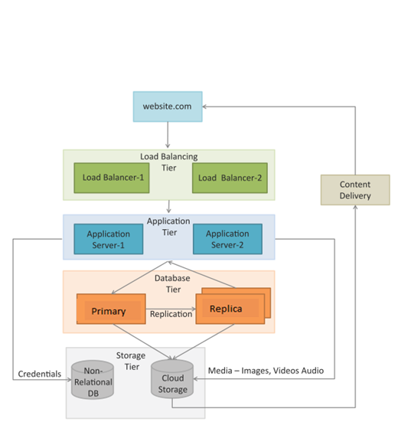
Reference Architectures – Content delivery apps
A typical deployment architecture for content delivery applications such as online photo albums, video webcasting, etc.
Both relational and non-relational data stores are shown in this deployment.
A content delivery network (CDN) which consists of a global network of edge locations is used for media delivery.
CDN is used to speed up the delivery of static content such as images and videos.

Slide 24
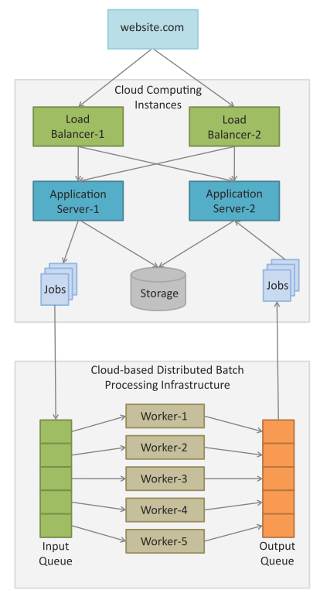
Reference Architectures – Analytics apps
A typical deployment architecture for compute intensive applications such as Data Analytics, Media Transcoding, etc.
Comprises of web, application, storage, computing/analytics and database tiers.
The analytics tier consists of cloud-based distributed batch processing frameworks such as Hadoop which are suitable for analyzing big data.
Data analysis jobs (such as MapReduce) jobs are submitted to the analytics tier from the application servers.
The jobs are queued for execution and upon completion the analyzed data is presented from the application servers.

Slide 25
Developing web applications in Python

Slide 26
Python Web Application Framework - Django
Django is an open source web application framework for developing web applications in Python.
A web application framework in general is a collection of solutions, packages and best practices that allows development of web applications and dynamic websites.

Slide 27
Python Web Application Framework - Django
Django provides a unified API to a database backend.
Thus web applications built with Django can work with different databases without requiring any code changes.
With this flexibility in web application design combined with the powerful capabilities of the Python language and the Python ecosystem, Django is best suited for cloud applications.

Slide 28
Python Web Application Framework - Django
Django is based on the Model-Template-View architecture and provides a separation of the data model from the business rules and the user interface.

Slide 29
Django Architecture
Django is Model-Template-View (MTV) framework.
Model
The model acts as a definition of some stored data and handles the interactions with the database. In a web application, the data can be stored in a relational database, non-relational database, an XML file, etc. A Django model is a Python class that outlines the variables and methods for a particular type of data.
Template
In a typical Django web application, the template is simply an HTML page with a few extra placeholders. Django’s template language can be used to create various forms of text files (XML, email, CSS, Javascript, CSV, etc.)
View
The view ties the model to the template. The view is where you write the code that actually generates the web pages. View determines what data is to be displayed, retrieves the data from the database and passes the data to the template.

Slide 30
Design methodology for IaaS service model
Component Design
Architecture Design
Deployment Design
Identify the building blocks of the application and functions to be performed by each block
Group the building blocks based on the functions performed and type of cloud resources required and identify the application components based on the groupings
Identify the inputs and outputs of each component
List the interfaces that each component will expose
Evaluate the implementation alternatives for each component (design patterns such as MVC, etc.)
Define the interactions between the application components
Guidelines for loosely coupled and stateless designs - use messaging queues (for asynchronous communication), functional interfaces (such as REST for loose coupling) and external status database (for stateless design)
Map the application components to specific cloud resources (such as web servers, application servers, database servers, etc.)

Slide 31
Design methodology for PaaS service model
For applications that use the Platform-as-a-service (PaaS) cloud service model, the architecture and deployment design steps are not required since the platform takes care of the architecture and deployment.
Component Design
In the component design step, the developers have to take into consideration the platform specific features.

Slide 32
Design methodology for PaaS service model
Platform Specific Software
Different PaaS offerings such as Google App Engine, Windows Azure Web Sites, etc., provide platform specific software development kits (SDKs) for developing cloud applications.
Sandbox Environments
Applications designed for specific PaaS offerings run in sandbox environments and are allowed to perform only those actions that do not interfere with the performance of other applications.
Deployment & Scaling
The deployment and scaling is handled by the platform while the developers focus on the application development using the platform-specific SDKs.
Portability
Portability is a major constraint for PaaS based applications as it is difficult to move the application to another environment

Slide 33
Cloud apps design - examples

Slide 34
Image Processing App Design
Functionality:
A cloud-based Image Processing application.
This application provides online image ﬁltering capability.
Users can upload image ﬁles and choose the ﬁlters to apply.
The selected ﬁlters are applied to the image and the processed image can then be downloaded.

Slide 35
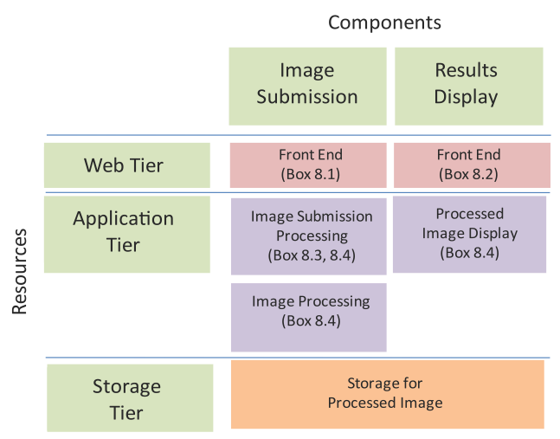
Image Processing App – Component Design
Component Design
Web Tier: The web tier for the image processing app has front ends for image submission and displaying processed images.
Application Tier: The application tier has components for processing the image submission requests, processing the submitted image and processing requests for displaying the results.
Storage Tier: The storage tier comprises of the storage for processed images.
Component design for Image Processing App

Slide 36
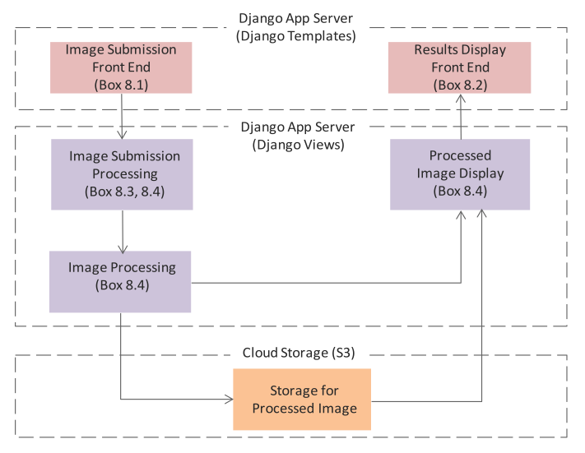
Image Processing App – Architecture Design
Architecture design step which deﬁnes the interactions between the application components.
This application uses the Django framework, therefore, the web tier components map to the Django templates and the application tier components map to the Django views.
A cloud storage is used for the storage tier.
Architecture design for Image Processing App

Slide 37
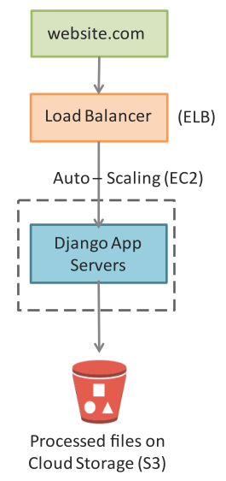
Image Processing App – Deployment Design
Deployment for the app is a multi-tier architecture comprising of load balancer, application servers and a cloud storage for processed images.
For each resource in the deployment the corresponding Amazon Web Services (AWS) cloud service is mentioned.
Deployment design for Image Processing App

Slide 38
Cloud Drive App Design
Functionality:
A cloud-based document storage (Cloud Drive) application.
This application allows users to store documents on a cloud-based storage.

Slide 39
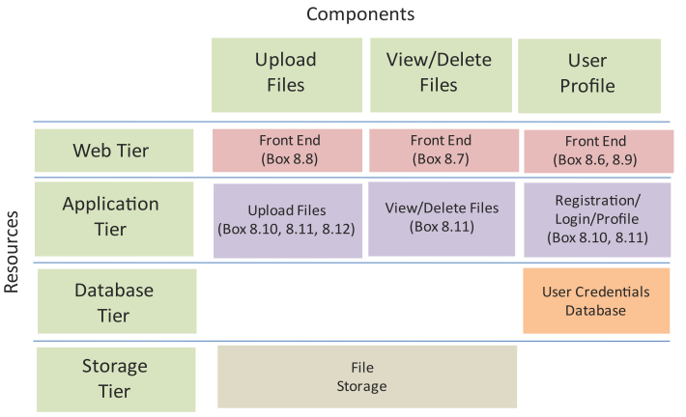
Cloud Drive App – Component Design
Component Design
Web Tier: The web tier for the Cloud Drive app has front ends for uploading ﬁles, viewing/deleting ﬁles and user proﬁle.
Application Tier: The application tier has components for processing requests for uploading ﬁles, processing requests for viewing/deleting ﬁles and the component that handles the registration, proﬁle and login functions.
Database Tier: The database tier comprises of a user credentials database.
Storage Tier: The storage tier comprises of the storage for ﬁles.
Component design for Cloud Drive App

Slide 40
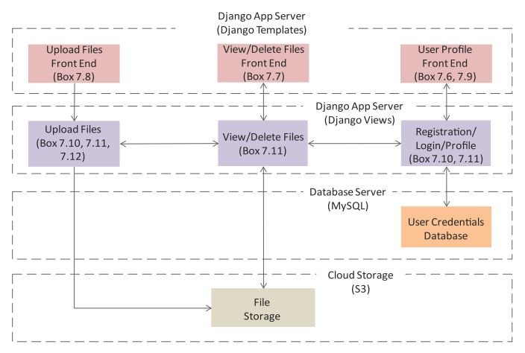
Cloud Drive App – Architecture Design
Architecture design step which deﬁnes the interactions between the application components.
A MySQL database is used for the database tier and a cloud storage is used for the storage tier.
Architecture design for Cloud Drive App

Slide 41
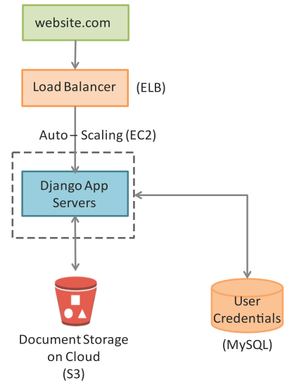
Cloud Drive App – Deployment Design
Deployment for the app is a multi-tier architecture comprising of load balancer, application servers, cloud storage for storing documents and a database server for storing user credentials.
Deployment design for Cloud Drive App

Slide 42
Social Media Analytics App Design
Functionality:
A cloud-based Social Media Analytics application.
This application collects the social media feeds (Twitter tweets) on a speciﬁed keyword in real time and analyzes the sentiments of the tweets and provides aggregate results.

Slide 43
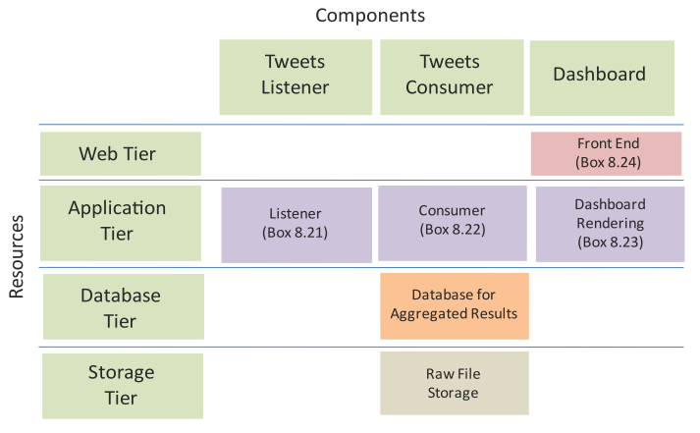
Social Media Analytics App – Component Design
Component Design
Web Tier: The web tier has a front end for displaying results.
Application Tier: The application tier has a listener component that collects social media feeds, a consumer component that analyzes tweets and a component for rendering the results in the dashboard.
Database Tier: A MongoDB database is used for the database tier and a cloud storage is used for the storage tier.
Storage Tier: The storage tier comprises of the storage for ﬁles.
Component design for Social Media Analytics App

Slide 44
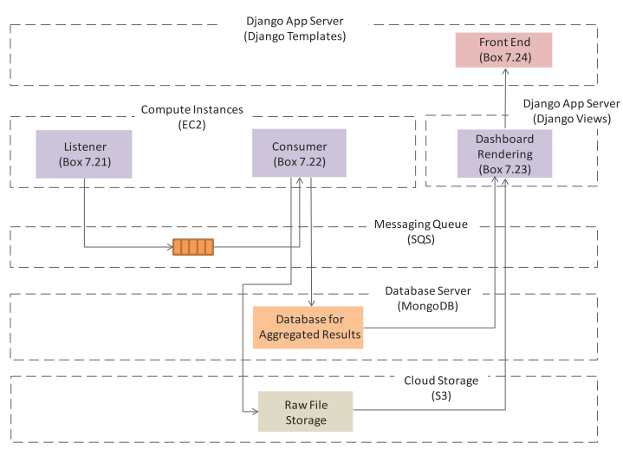
Social Media Analytics App – Architecture Design
Architecture design step which deﬁnes the interactions between the application components.
To make the application scalable the feeds collection component (Listener) and feeds processing component (Consumer) are separated.
The Listener component uses the Twitter API to get feeds on a speciﬁc keyword (or a list of keywords) and enqueues the feeds to a queue.
The Consumer component (that runs on a separate instance) retrieves the feeds from the queue and analyzes the feeds and stores the aggregated results in a separate database.
The aggregate results are displayed to the users from a Django application.
Architecture design for Social Media Analytics App

Slide 45
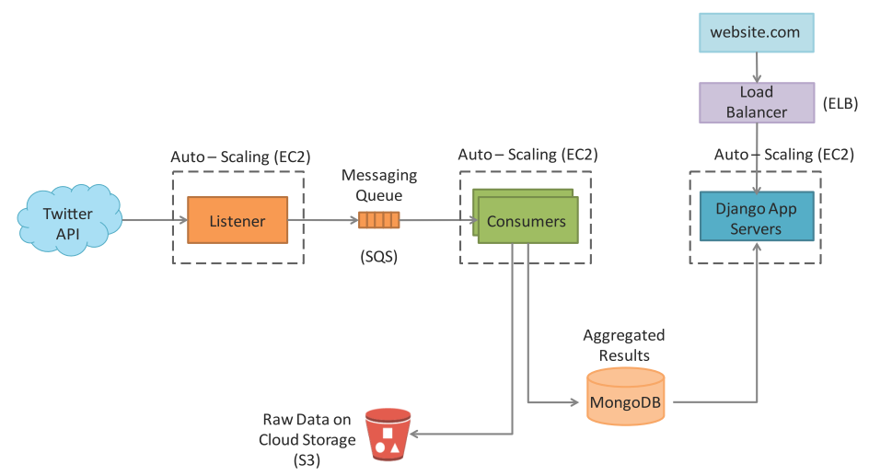
Social Media Analytics App – Deployment Design
Deployment for the app is a multi-tier architecture comprising of load balancer, application servers, listener and consumer instances, a cloud storage for storing raw data and a database server for storing aggregated results.
Deployment design for Social Media Analytics App

Slide 46
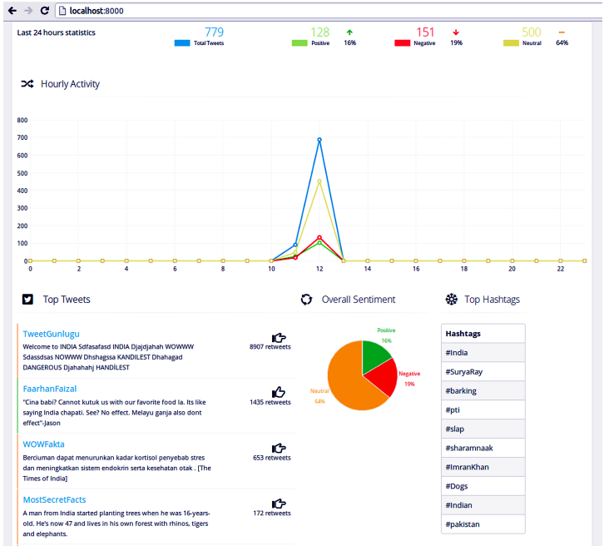
Social Media Analytics App – Dashboard

